Slide 1

RUMYPET(R U my pet?)
Team Groza
Kim Tae Hong (20132335)
(Presenter) Kim Chan Il (20150577)
Paeng Jin Wook (20154645)
Notes:
Hello everyone, we’re team Groza.
I’m a presenter 팽진욱

Slide 2
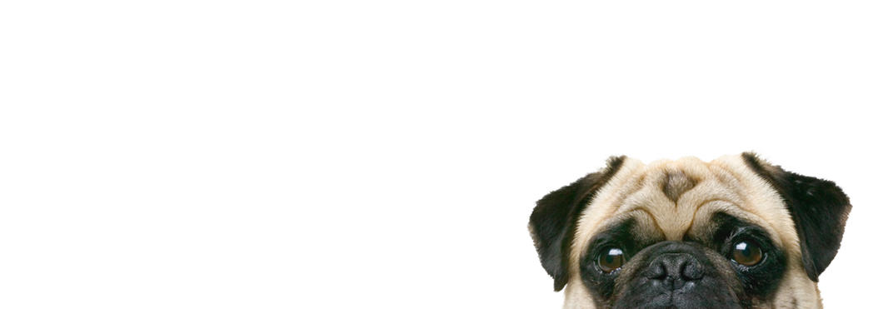
Contents
Schedule & Progress
Problems & Solutions
Plans
Q&A

Slide 3
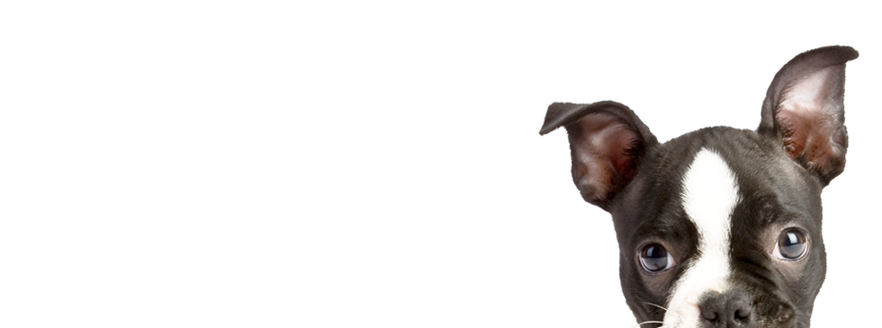
1. SCHEDULE & PROGRESS

Slide 4
SCHEDULE
Week | To-Do (can be changed)
Week 1 | Project goal setting
Week 2 | Propose project
Week 3 | Design: User Interface, System Architectures Setting : Development Environment,
Week 4 | Workshop for collecting data set( Dog cafe, park, .. etc) Hong : Launching AWS server environment Chan : Applying Design to Android Studio Paeng : Develop Pre-processing Method and apply it to Fingerprint picture.
Week 5 | Hong : build the basic code in the server Chan : Develop Android Application Paeng : Apply Pre-processing method to the dog’s nose picture using python opencv.
Week 6 | Hong : Complete the developing basic Server Core Chan : Develop Android Application Paeng : Develop Feature Detecting & Matching
Week 7 | Hong : connect the server and application Chan : Complete Android Application Paeng : Refactoring Code to get good performance
Week 8 | Midterm Examination
4
Notes:
This is our schedule.
This week, we’re supposed to go workshop to collect the data of dog nose.
Because we don’t have any data.

Slide 5
Week 9 |  | Hong : sync with server Paeng : sync with client Chan : Intermediate check of our development status
Week 10 |  | Hong : complete the server and android application. Paeng : complete the Application UI Chan : complete the algorithm.
Week 11 |  | We will meet together and feedback each other’s code.
Week 12 |  | Hong : Implement improvement factor at Server Paeng : Implement improvement factor at algorithm Chan : Implement improvement factor at application UI
Week 13 |  | First Demonstration and feedback
Week 14 |  | First Revising our project
Week 15 |  | Final Demonstration
Week 16 |  | Final Examination
SCHEDULE
5
Notes:
This is the schedule later.

Slide 6
Role of this week
Week 5 | Hong : build the basic code in the server Chan : Develop Android Application Paeng : Apply Pre-processing method to the dog’s nose picture using python opencv.
Week 4 | Workshop for collecting data set ( Dog cafe, park, .. etc)
6
Notes:
As I said, we’re supposed to go workshop to collect some data.
But, It is so simple, We don’t want you to blame me.
*So we did some extra works.
--ppt read--
We will gonna show you the modified schedule next week.

Slide 7

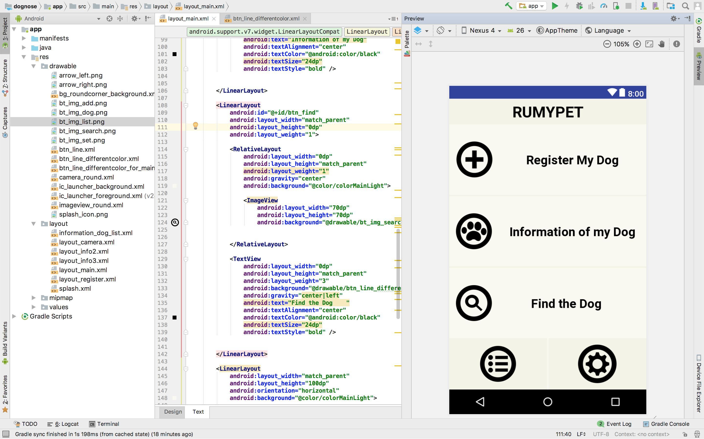
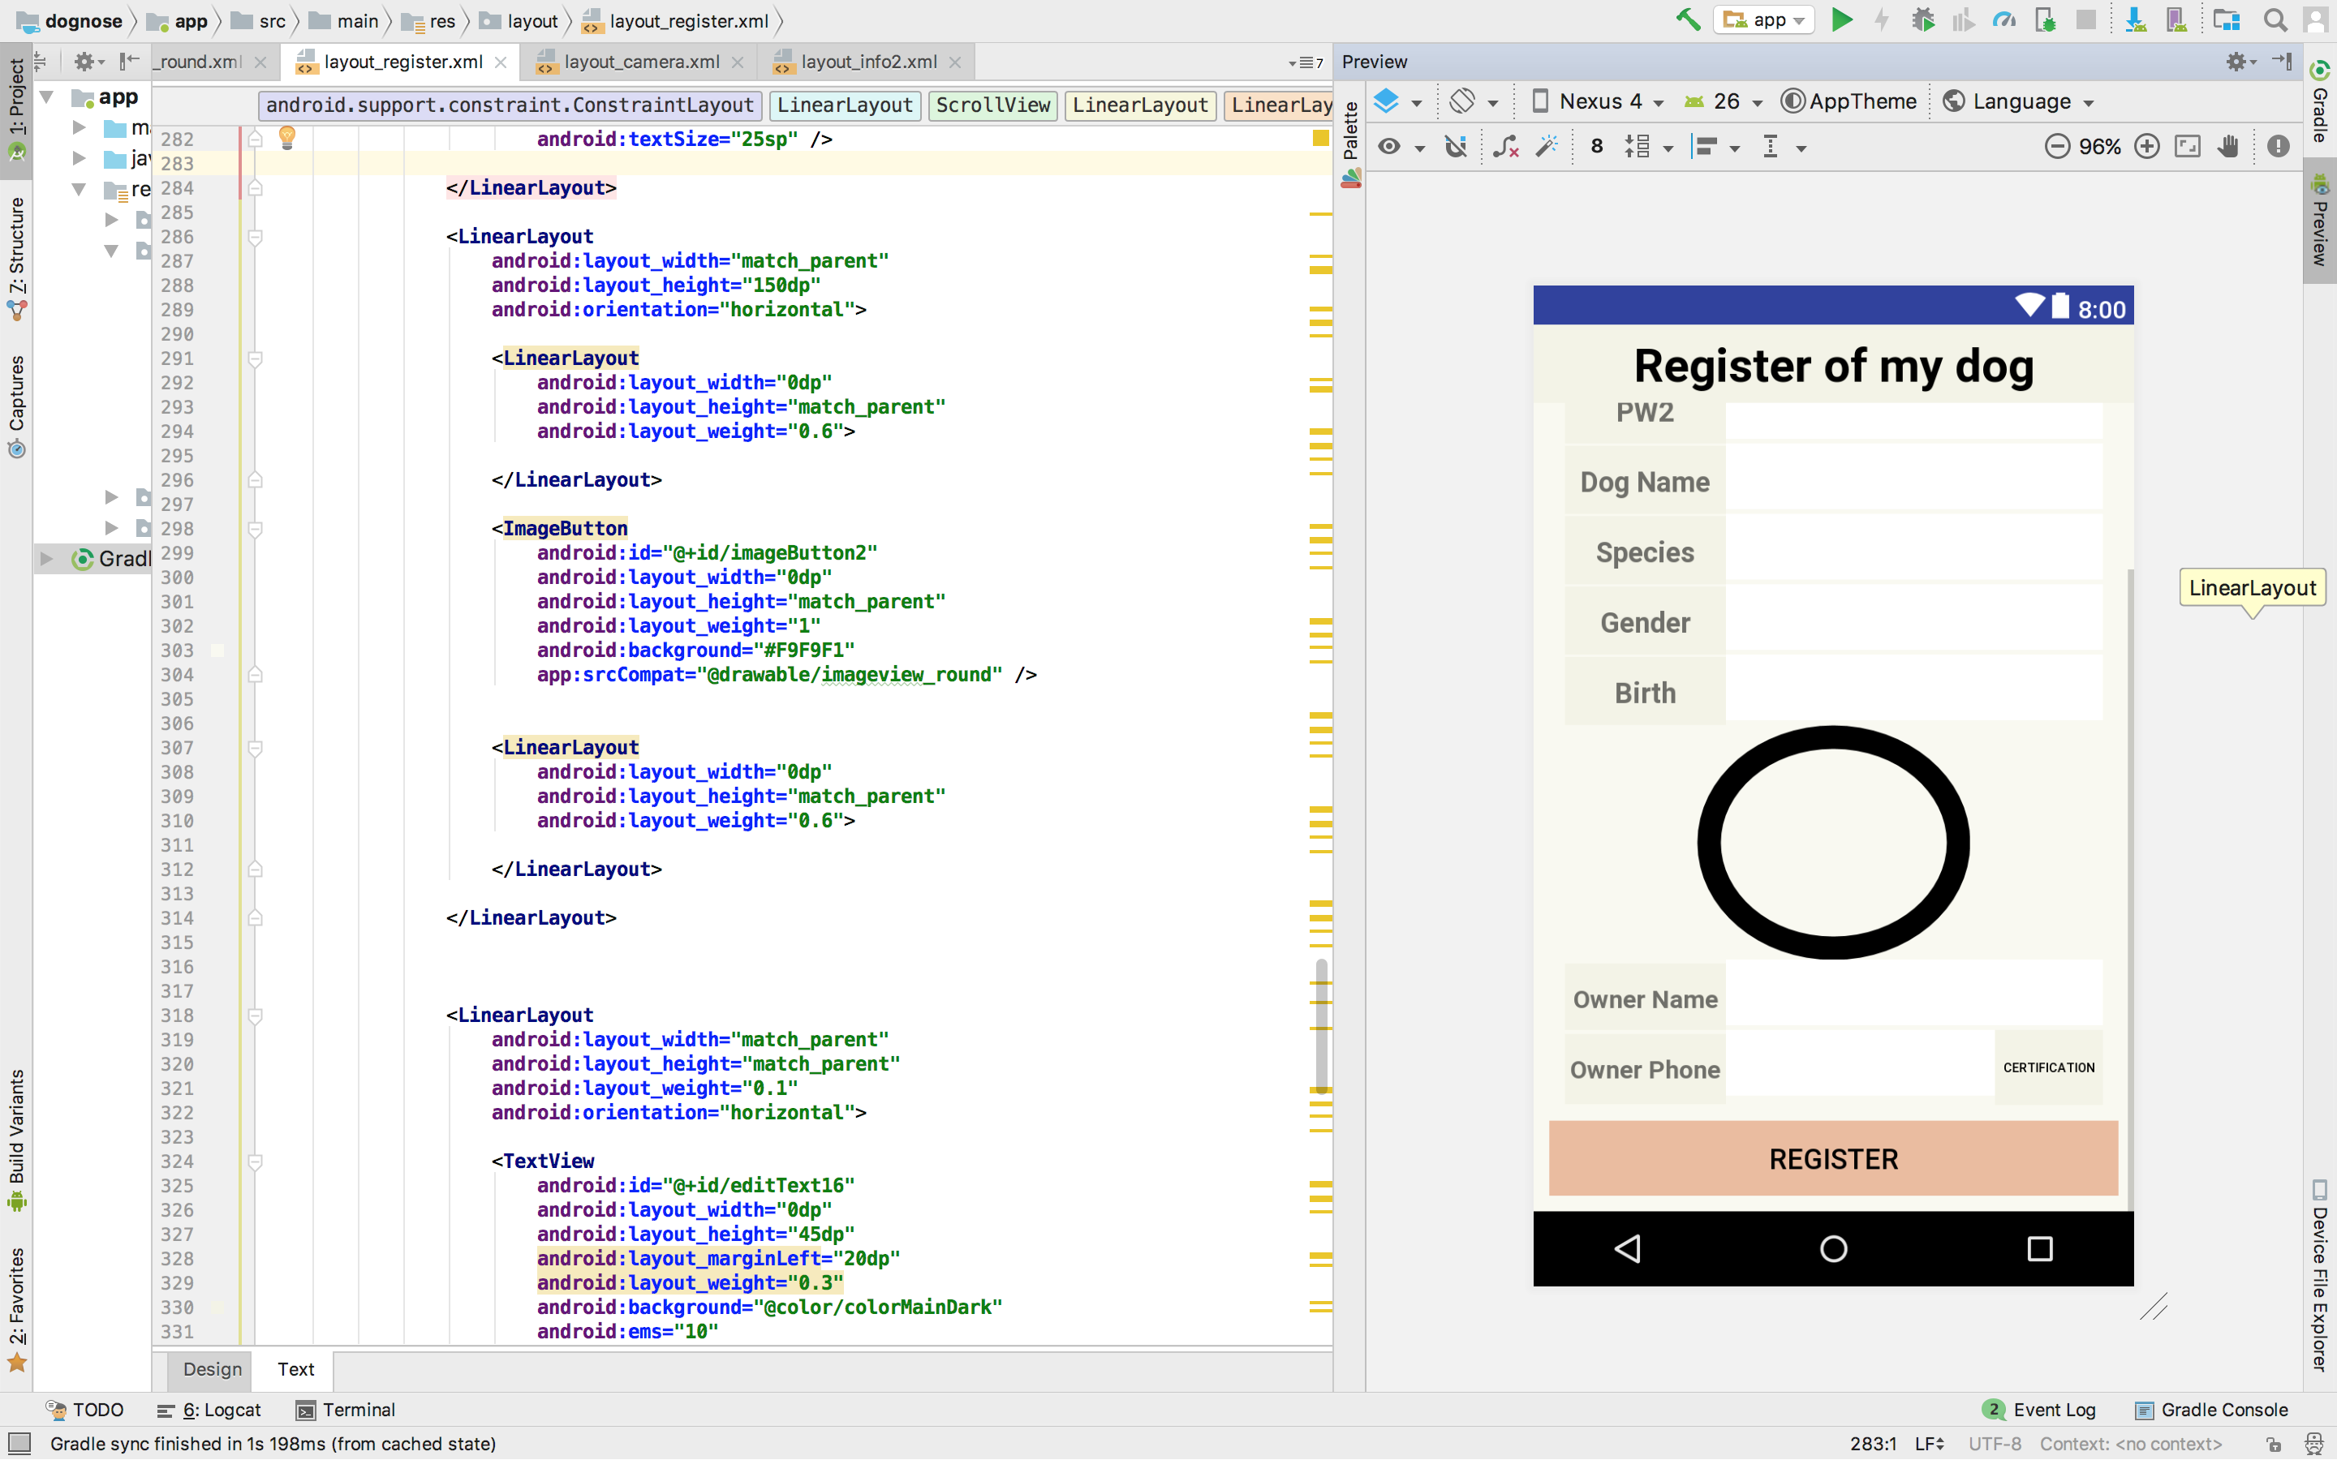
Schedule & Progress – Kim Chan Il
“Improve Detail Design of RUMYPET’s UI”
7
Notes:
This is the UI Deisign we did last week.
Using this, Chan il Kim applied this into Android Studio.

Slide 8
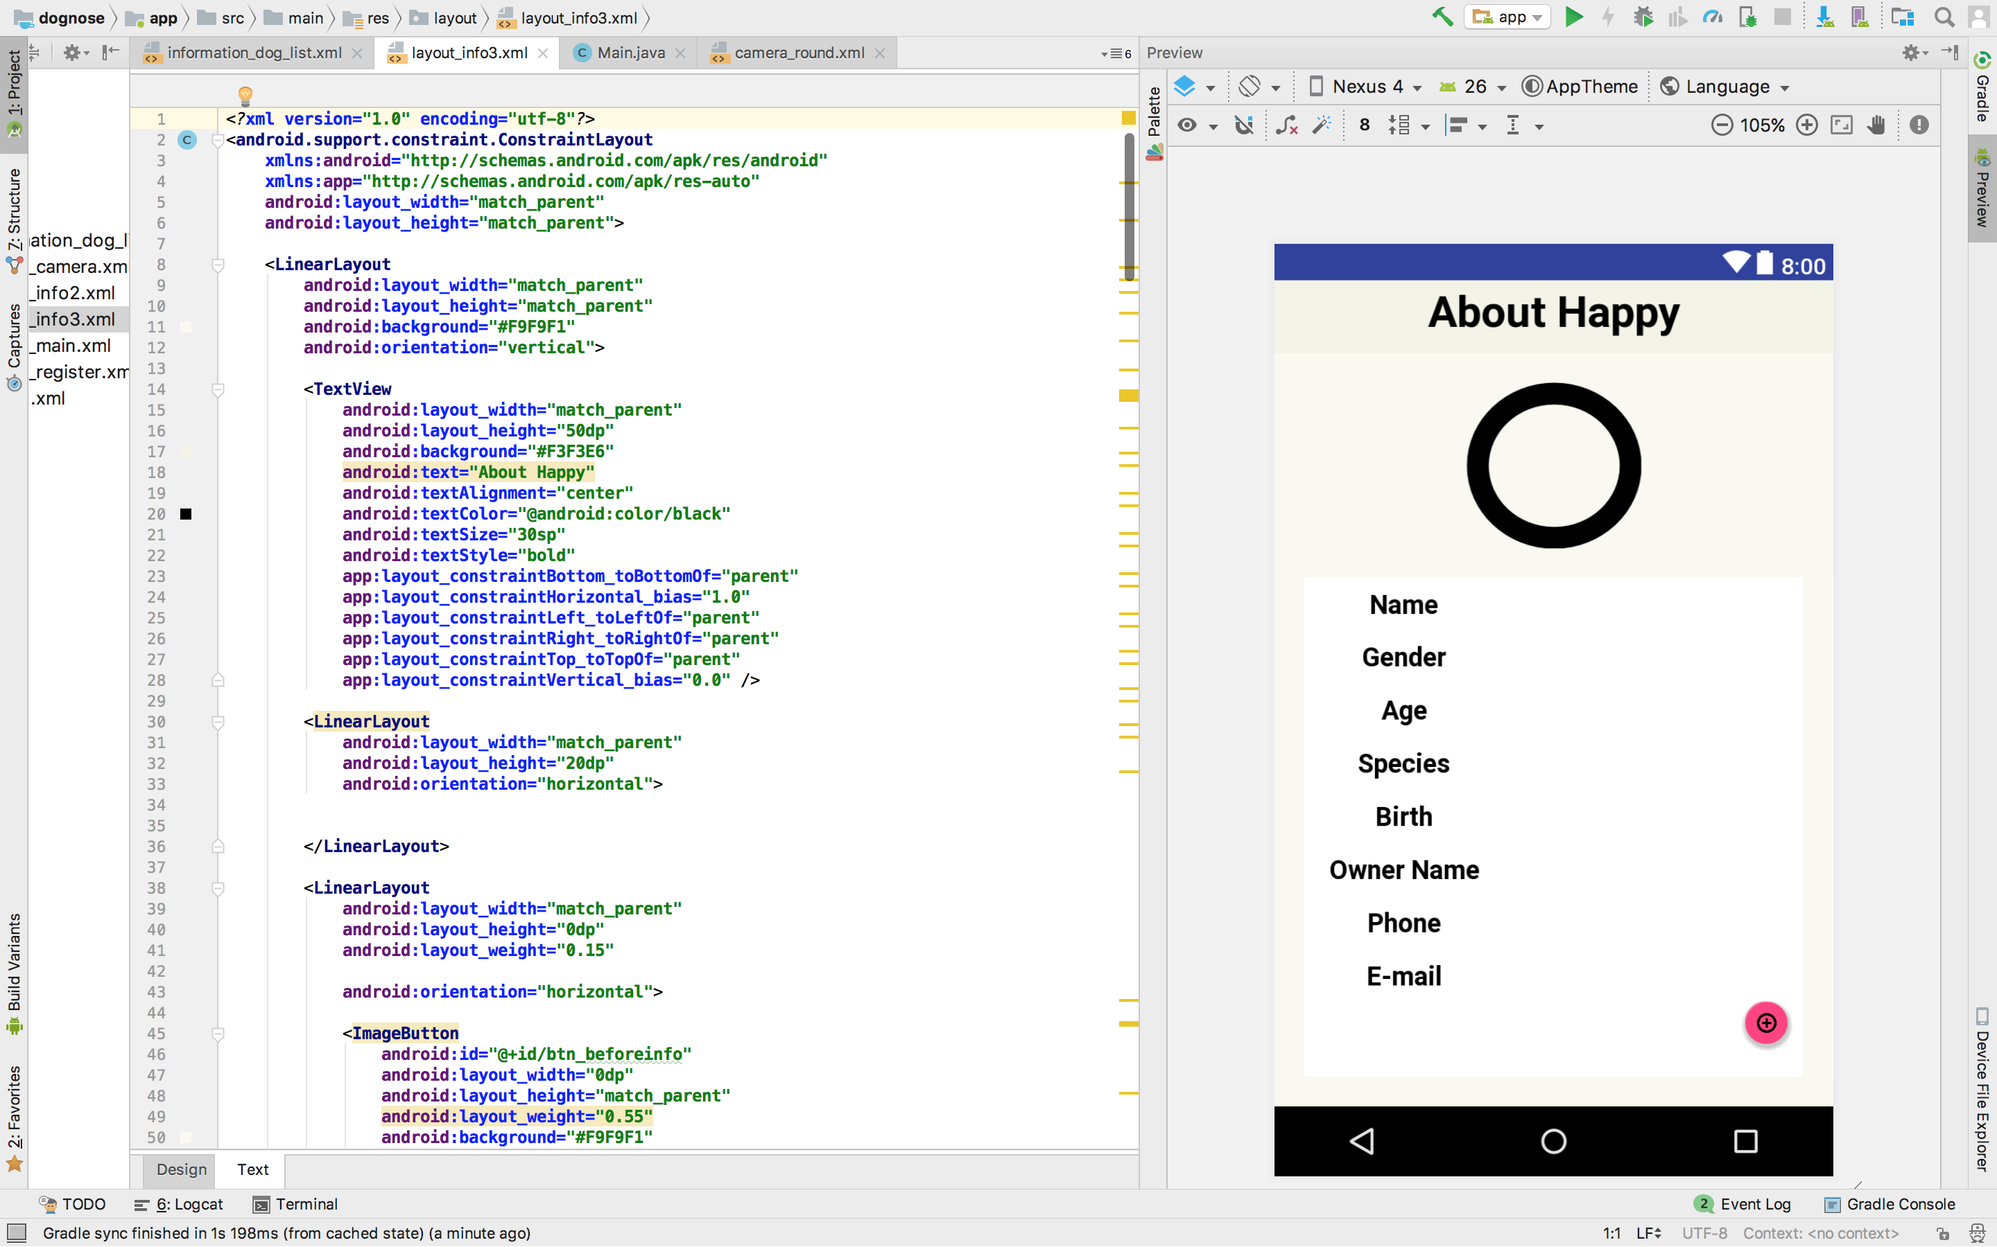
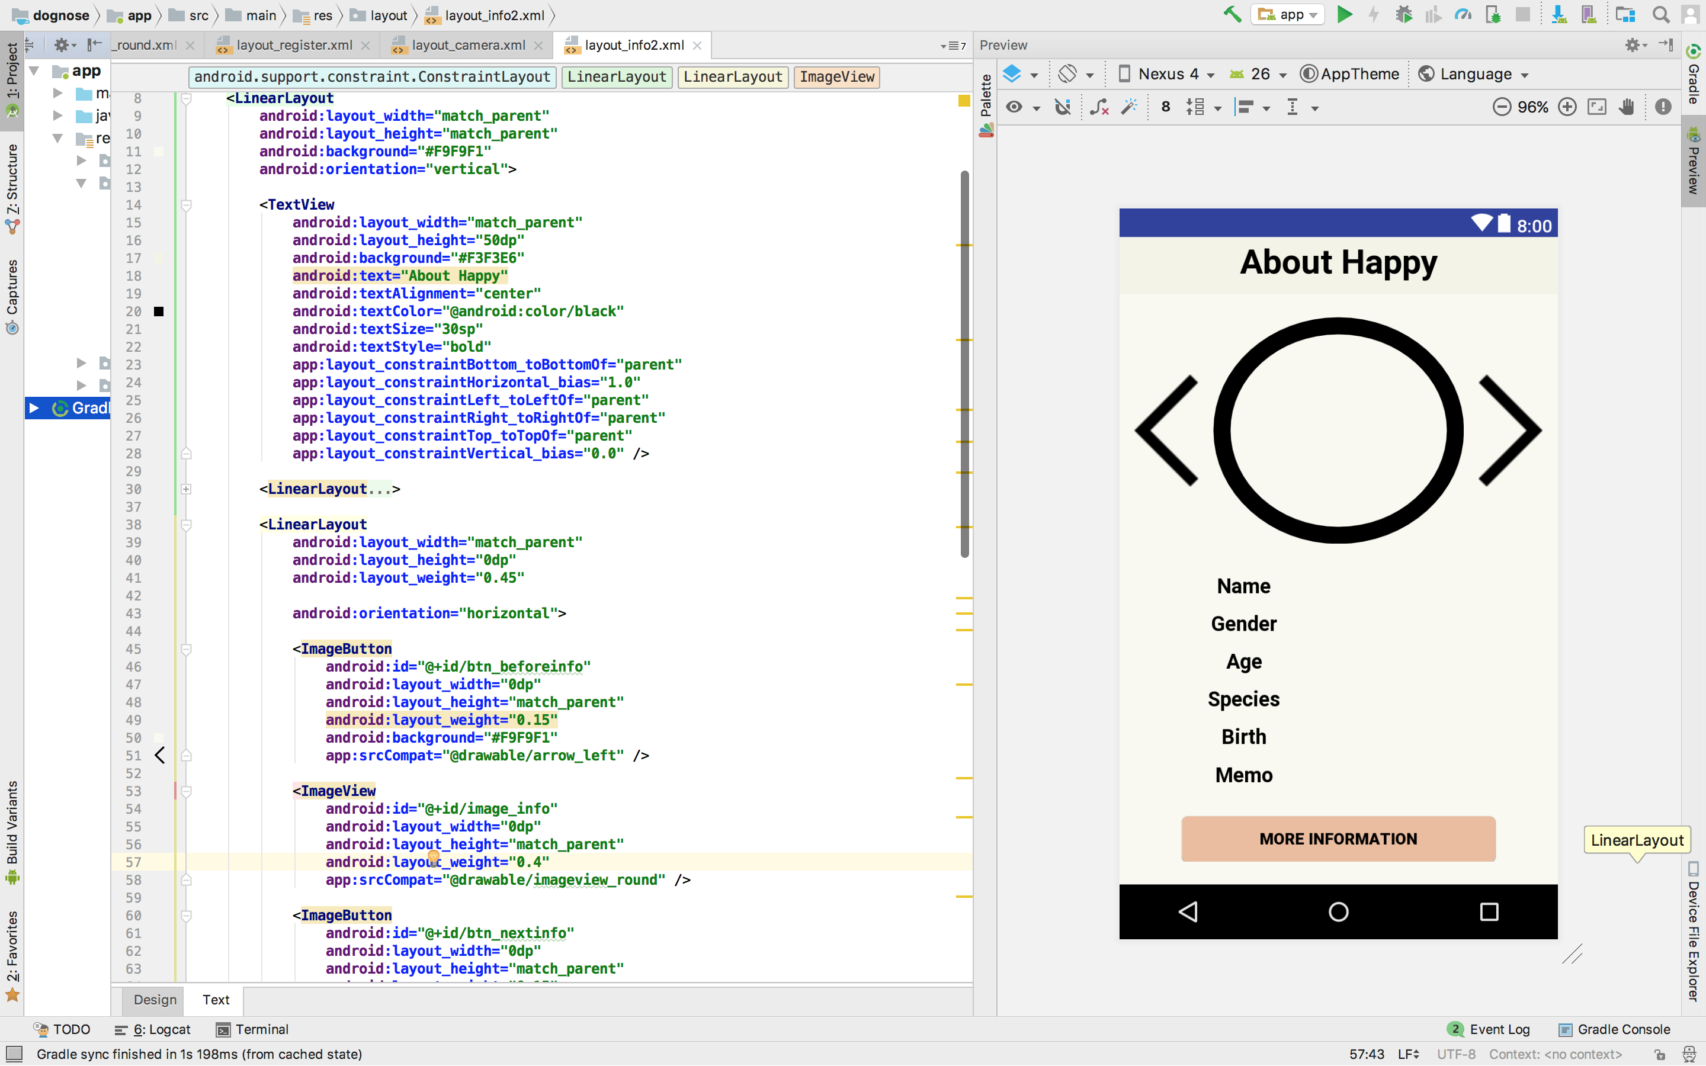
Schedule & Progress – Kim Chan Il
“Improve the details of RUMYPET’s UI Design”
8
Notes:
This is what he have done.

Slide 9
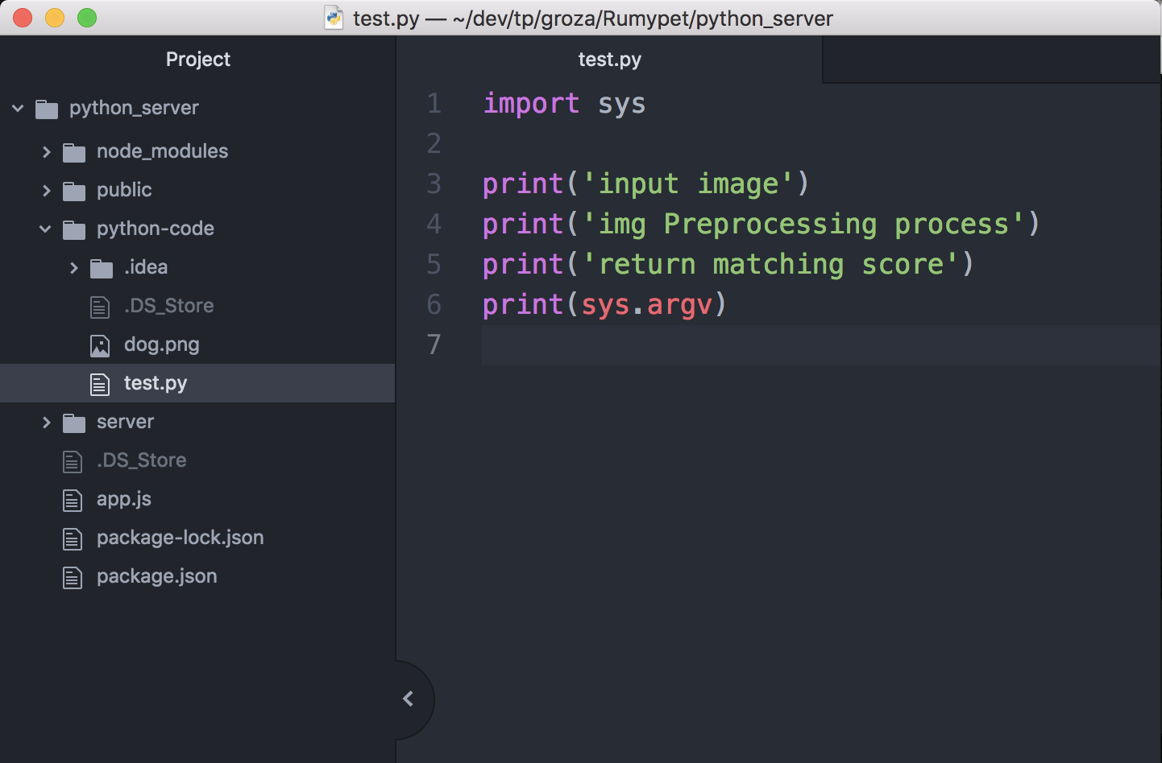
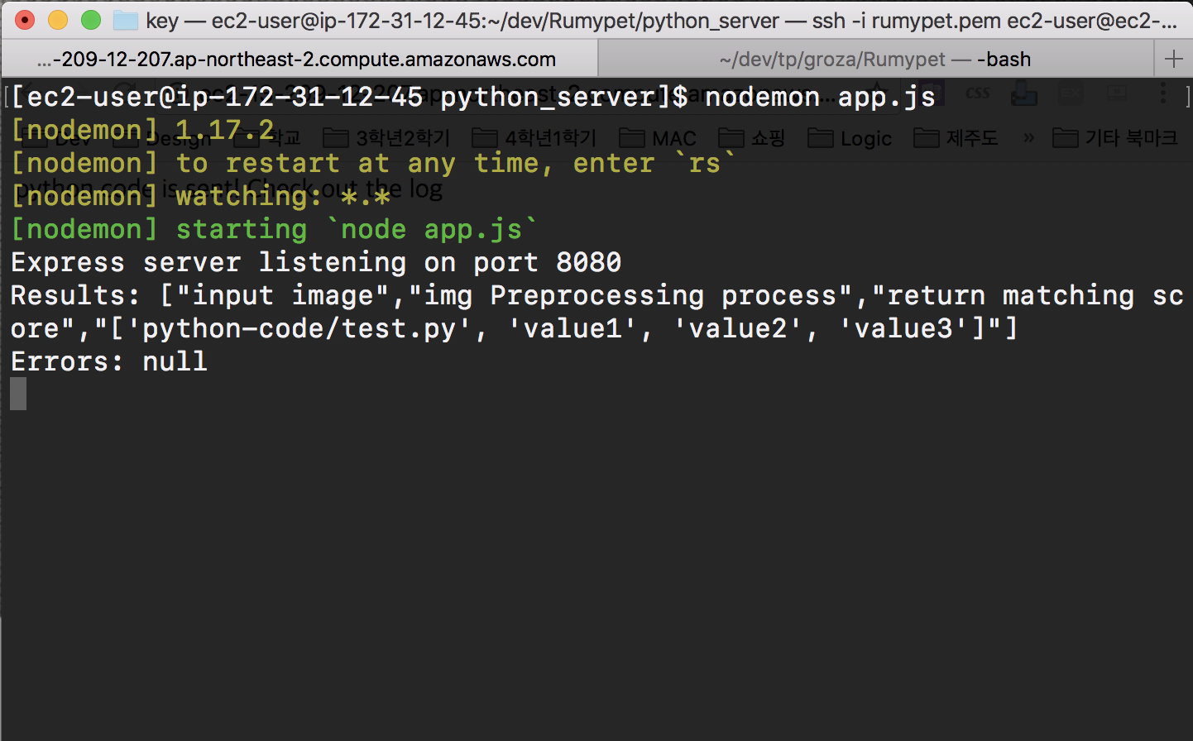
Schedule & Progress – Kim Tae Hong
“Using the node.js to pop up the server
and Running a simple python code on the Server”
9
Notes:
Left one is the simple python code for testing
Right one is the return value that came from the python code. We get the string through the server using nodejs.

Slide 10
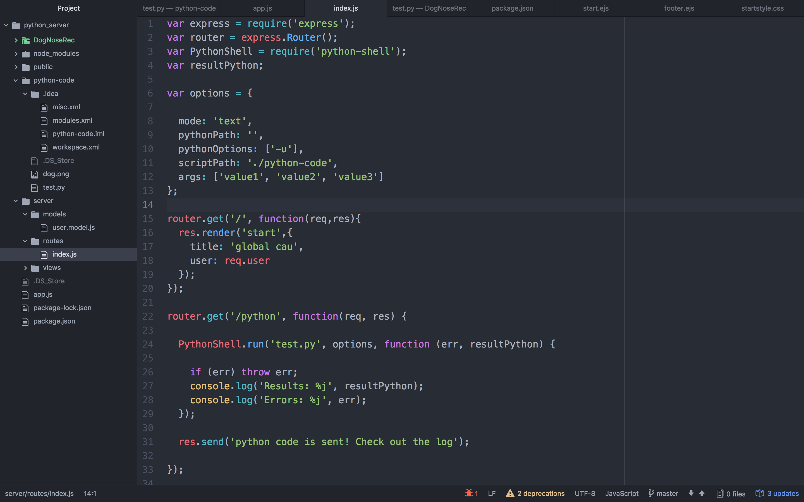
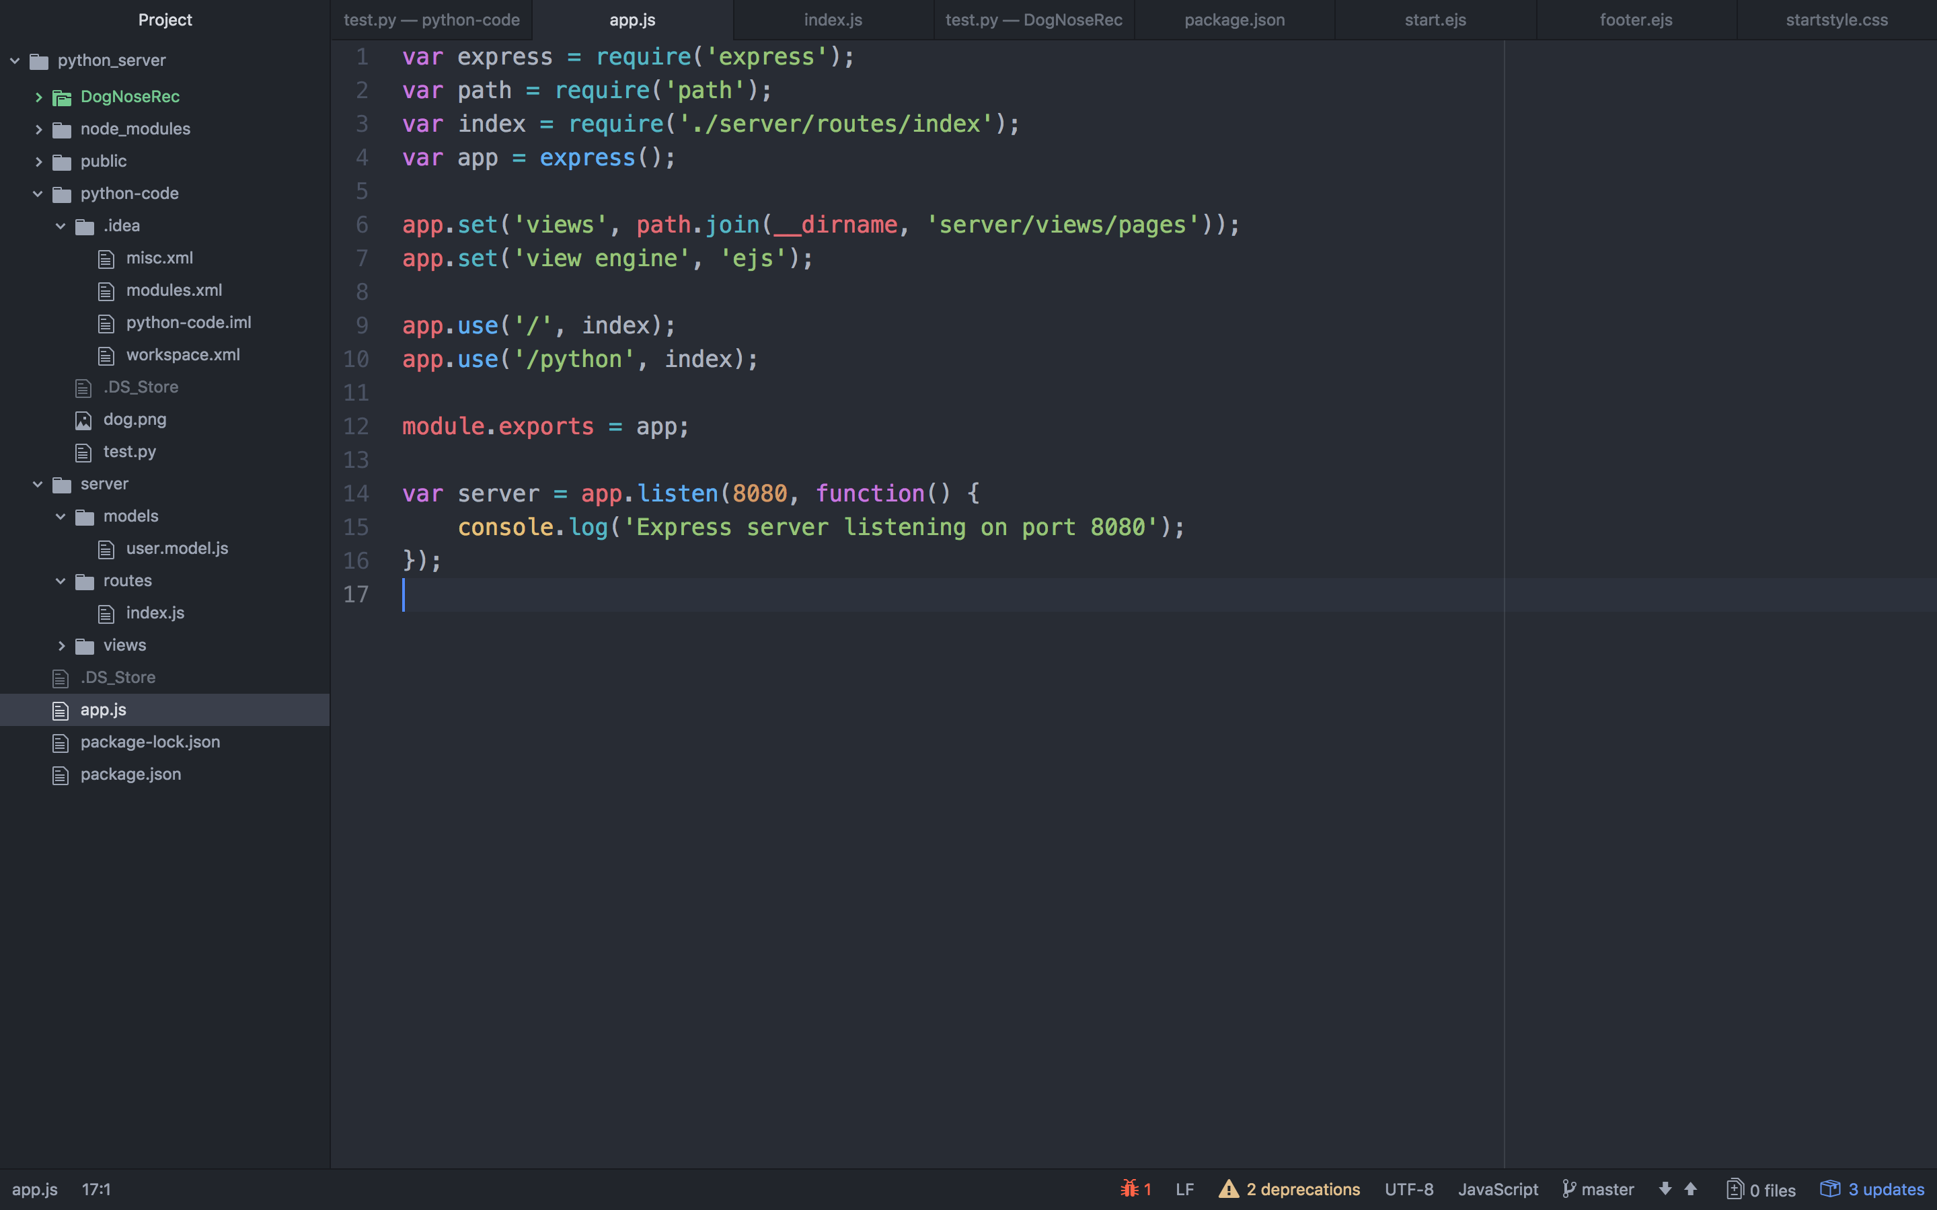
Schedule & Progress – Kim Tae Hong
“Using the node.js to pop up the server
and Running a simple python code on the Server”
10
Notes:
Next, Tae hong Kim launched our own cloud server using Amazon web service.
Because we don’t have our server computer.

Slide 11
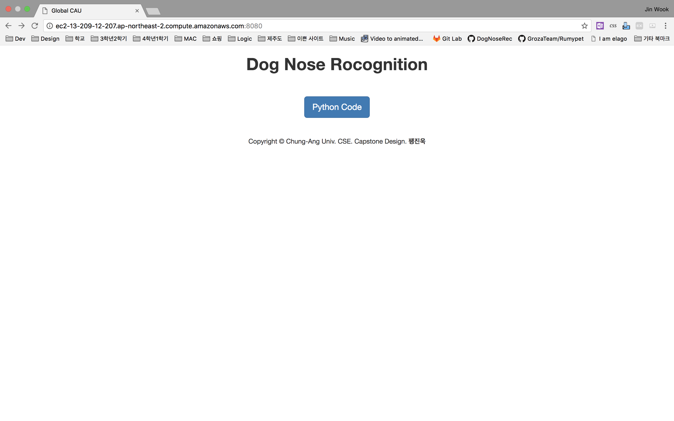
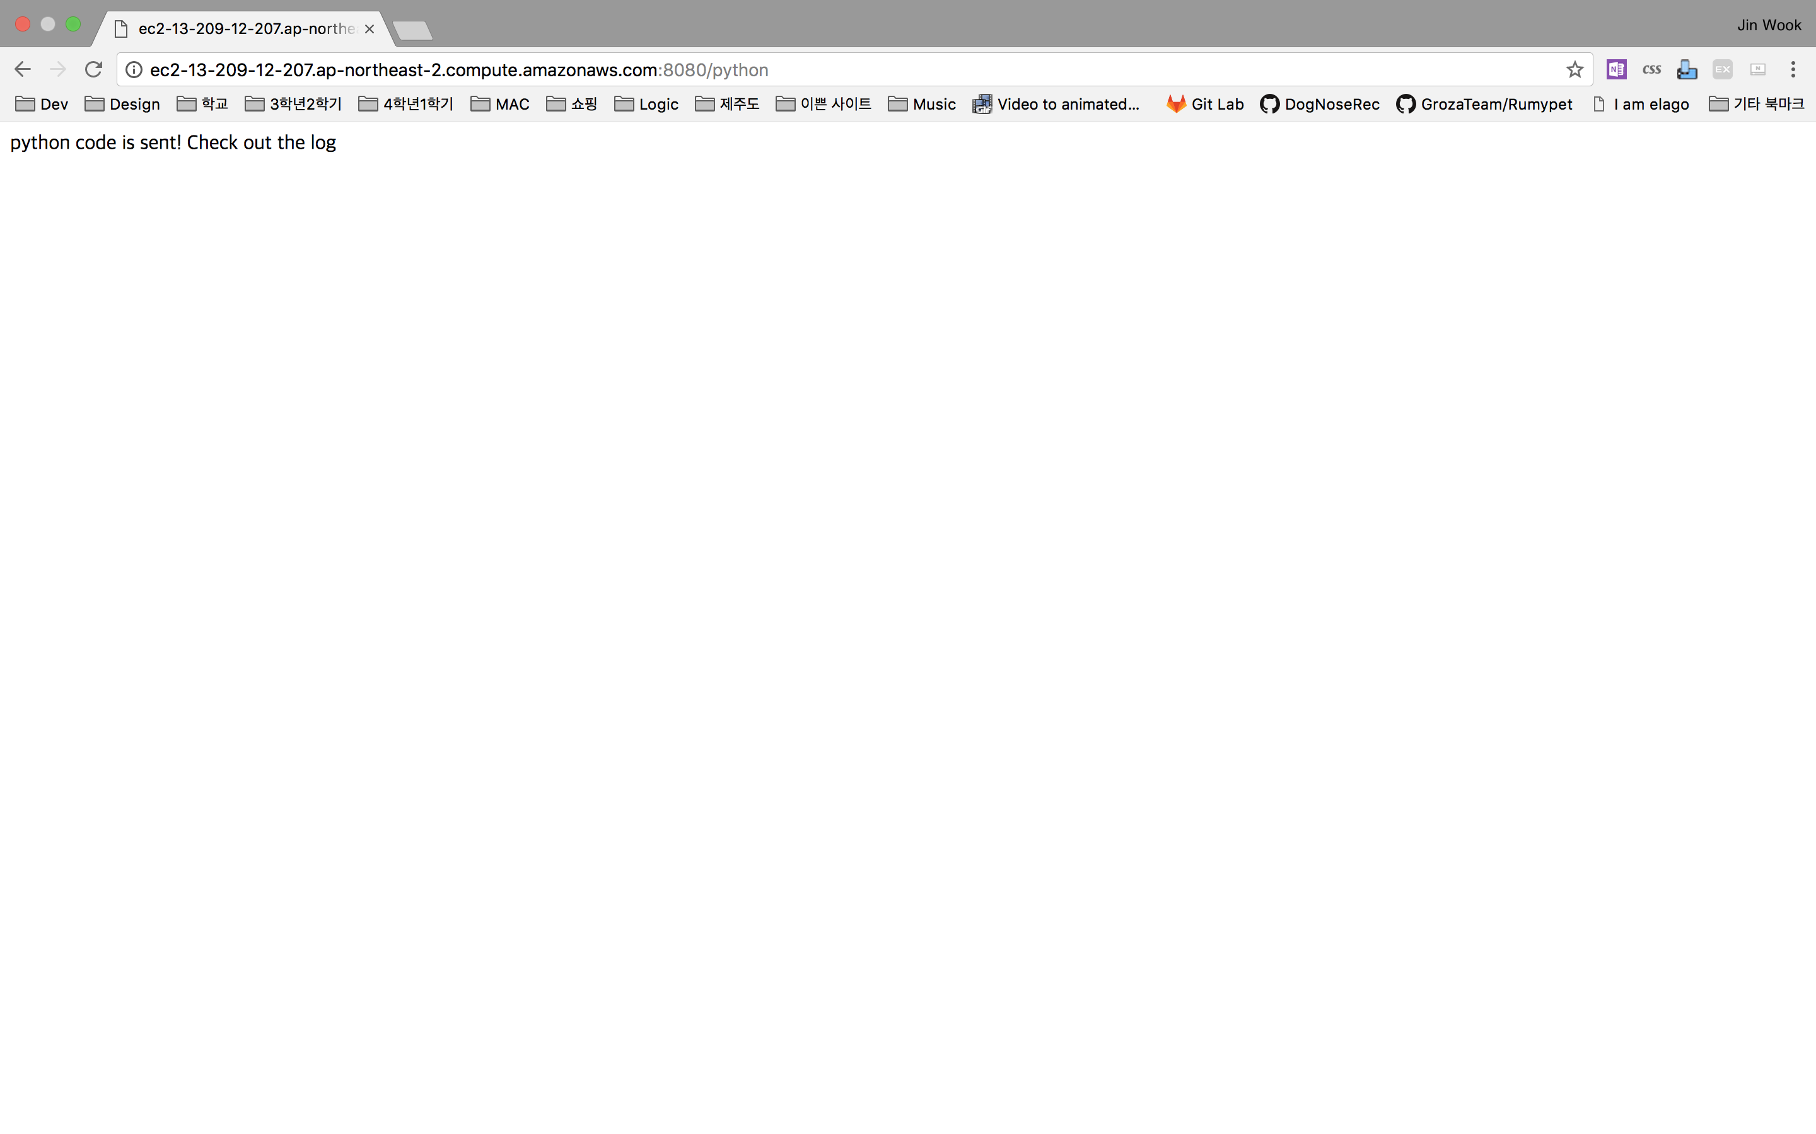
Schedule & Progress – Kim Tae Hong
“Using the node.js to pop up the server
and Running a simple python code on the Server”
11
Notes:
Next, Tae hong Kim launched our own cloud server using Amazon web service.
Because we don’t have our server computer.

Slide 12
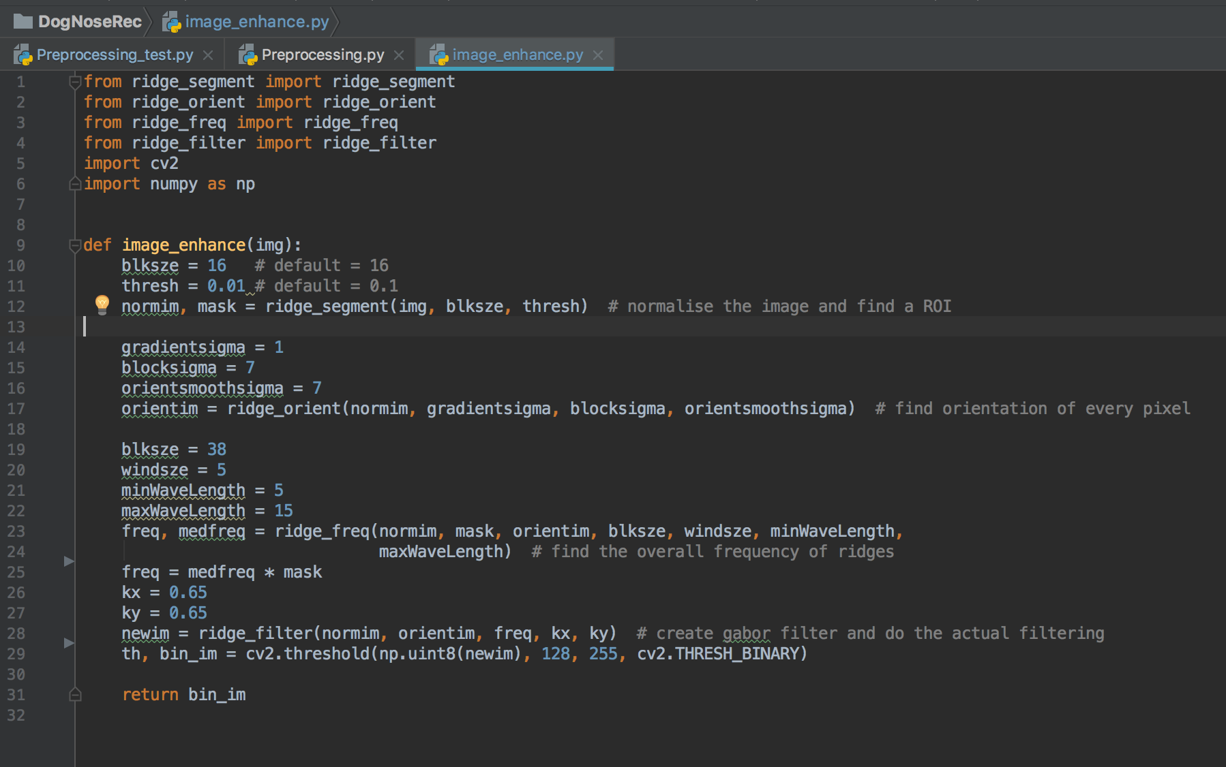
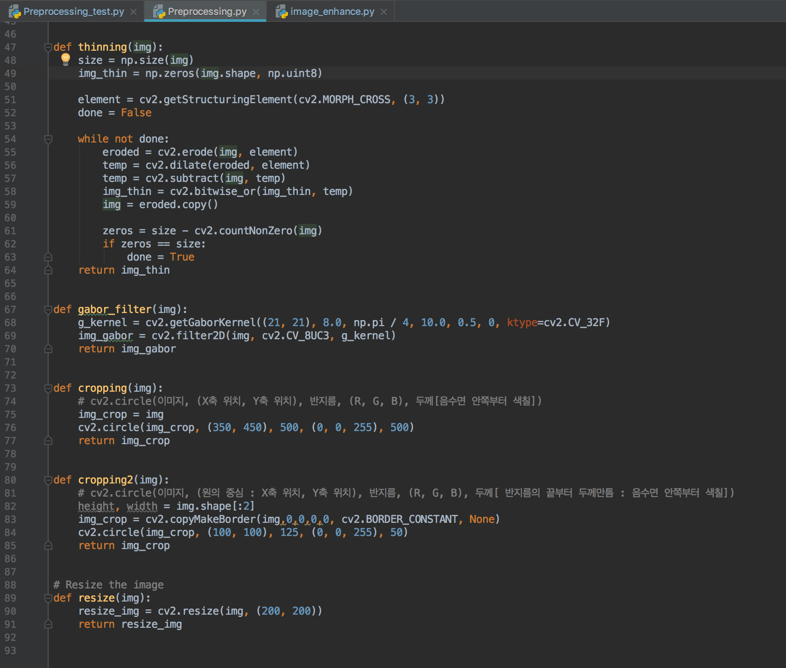
Schedule & Progress – Paeng Jin Wook
“Develop Pre-processing Method in the way
for the project & Apply it to Dog’s Nose”
12
Notes:
Next, This is what I have done. I developed pre-processing method and applied it to fingerprint picture.
I used OpenCV – Python, and these are the version of them.
The principle of Fingerprint recognition and Dog Nose Recognition is very Similar.

Slide 13
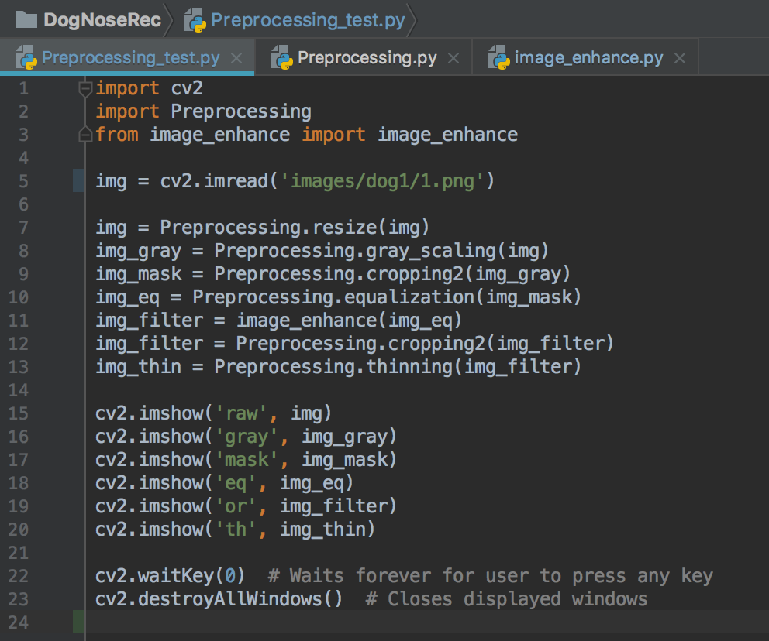
Schedule & Progress – Paeng Jin Wook
“Develop Pre-processing Method in the way
for the project & Apply it to Dog’s Nose”
13
Notes:
Next, This is what I have done. I developed pre-processing method and applied it to fingerprint picture.
I used OpenCV – Python, and these are the version of them.
The principle of Fingerprint recognition and Dog Nose Recognition is very Similar.

Slide 14
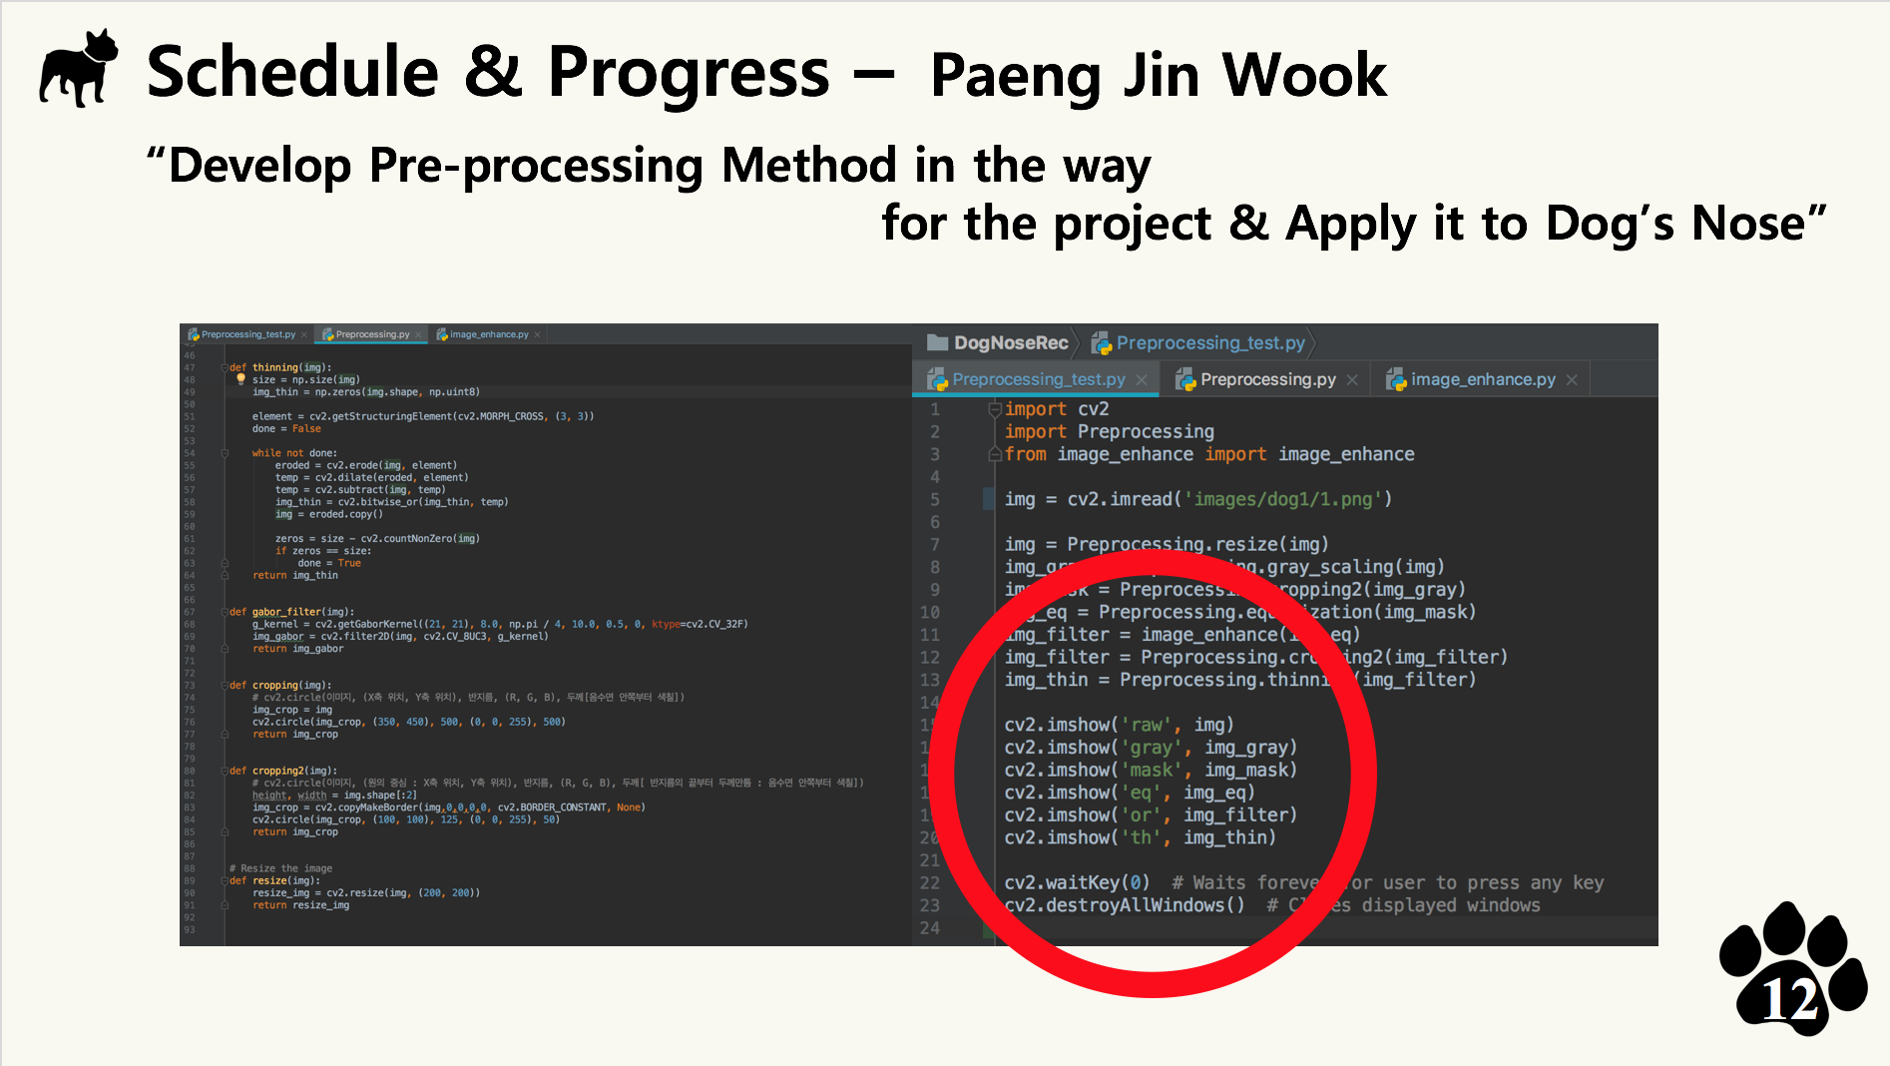
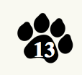
Notes:
Next, This is what I have done. I developed pre-processing method and applied it to fingerprint picture.
I used OpenCV – Python, and these are the version of them.
The principle of Fingerprint recognition and Dog Nose Recognition is very Similar.

Slide 15
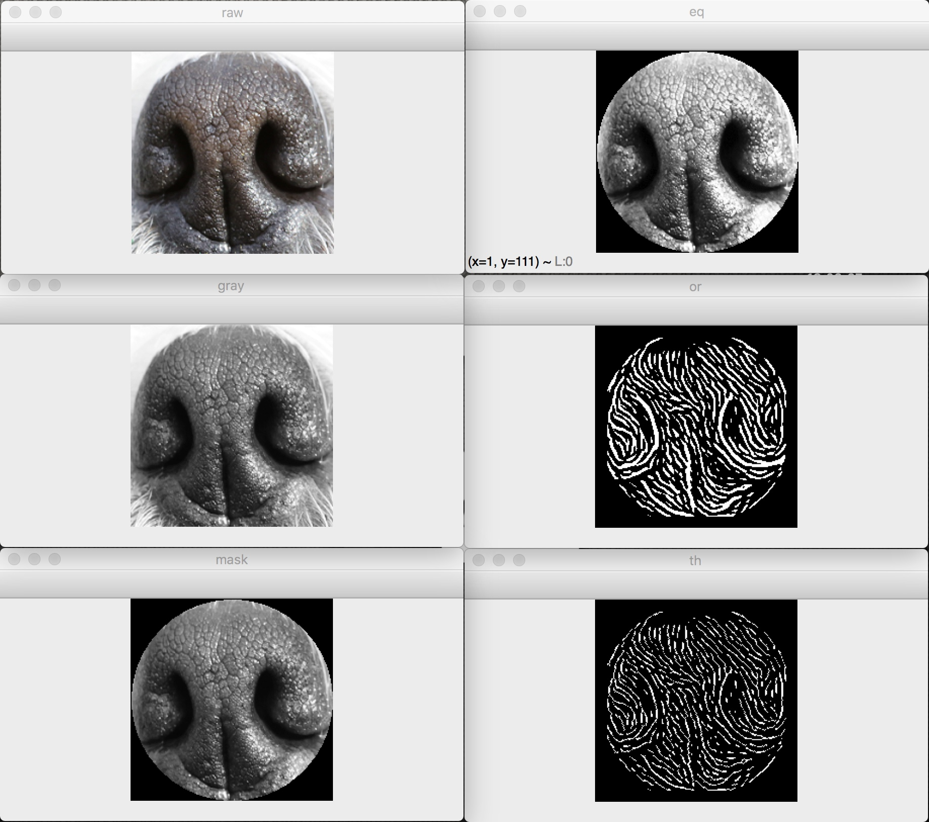
Schedule & Progress – Paeng Jin Wook
“Develop Pre-processing Method in the way
for the project & Apply it to Dog’s Nose”
14
Notes:
Next, This is what I have done. I developed pre-processing method and applied it to fingerprint picture.
I used OpenCV – Python, and these are the version of them.
The principle of Fingerprint recognition and Dog Nose Recognition is very Similar.

Slide 16
Schedule & Progress – Paeng Jin Wook
“Develop Pre-processing Method in the way
for the project & Apply it to Dog’s Nose”
15
Notes:
Next, This is what I have done. I developed pre-processing method and applied it to fingerprint picture.
I used OpenCV – Python, and these are the version of them.
The principle of Fingerprint recognition and Dog Nose Recognition is very Similar.

Slide 17
Schedule & Progress – Paeng Jin Wook
“Develop Pre-processing Method in the way
for the project & Apply it to Dog’s Nose”
16
Notes:
Next, This is what I have done. I developed pre-processing method and applied it to fingerprint picture.
I used OpenCV – Python, and these are the version of them.
The principle of Fingerprint recognition and Dog Nose Recognition is very Similar.

Slide 18
2. PROBLEMS & SOLUTION

Slide 19
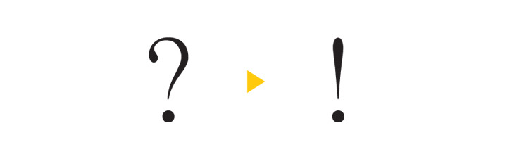
PROBLEMS & SOLUTIONS
No problem, this week
18
Notes:
--ppt reading--
Now, we have our own server!

Slide 20
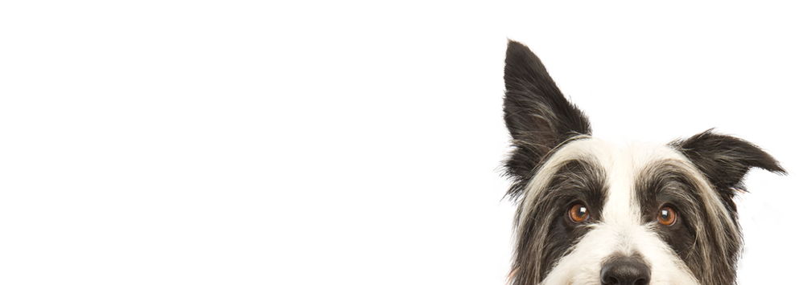
3. PLANS

Slide 21
PLANS for next week
Week 6 | Hong : Complete the developing basic Server Core Chan : Develop Android Application Paeng : Develop Feature Detecting & Matching
20
Notes:
ppt reading

Slide 22
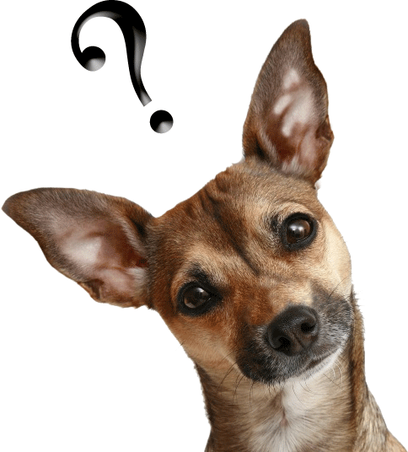
Q&A

Slide 23
Thank you!

